Slide 1

April 17th , 2020
COVID-19 ANALYSIS
Studying the Virus expansion with Regression and ML
Predictive Analytics Course
Group 4 - Guida Giulia, Muttoni Davide, Ticozzi Paolo

Slide 2

Introduction
Country_Prov
Dataset
Date
Covid_19_Data
Regarding 7926 updates about COVID-19 from all the world

Slide 3
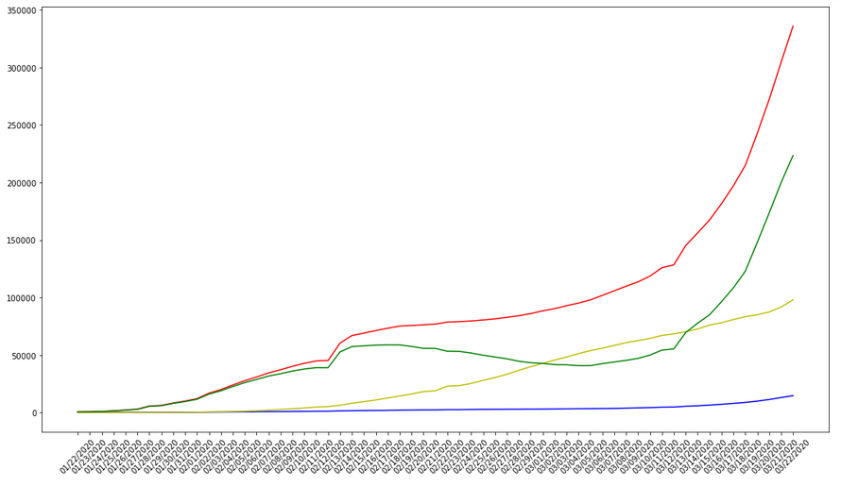
Our Target Variables
Our Goal: predict the short-term flow of our targets
Confirmed
Deaths
Recovered
Active
COVID-19 cumulative stats - Worldwide

Slide 4
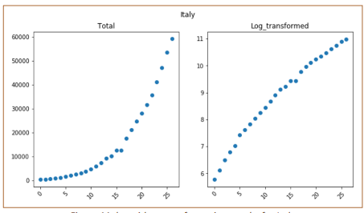
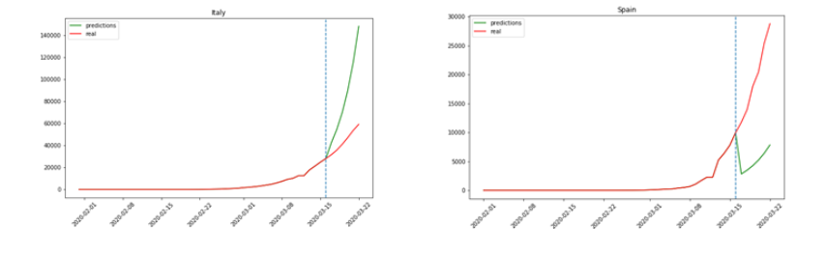
Can we apply log transformation on our targets?
We noticed a semi exponential growth in phase 1 of all the countries
Idea: we should log-transform our data!
Linear regression applied
Conclusions…
Logaritmic Transformation for
Italy – Confirmed Cases
Explanatory: datecode
Target (one at a time): confirmed, deaths, active
NO!

Slide 5
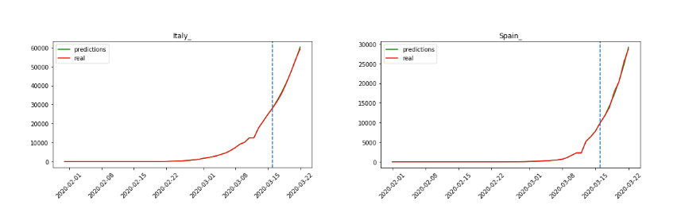
Is it possible to predict the trend of the cases for each country & region through autoregression components?
We applied the new function that is updating the lags to our data, and the predictions were more precise
The function is recomputing the regression for each country, without a general model
Explanatory: datem, target_variable_t-1, target_variable_t-2, target_variable_t-3
Target (one at a time): confirmed, deaths, active

Slide 6
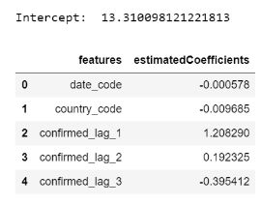
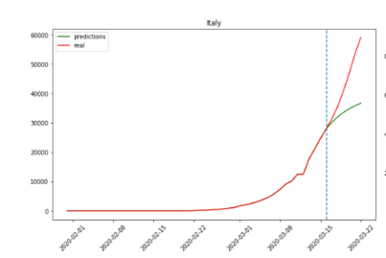
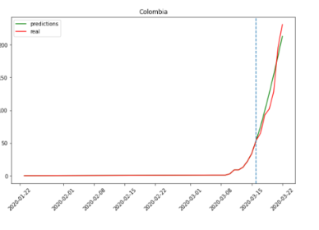
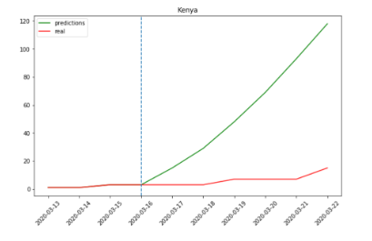



Is it possible to predict the trend of coronavirus cases for the whole world? - Ridge Regression
Same preprocessing as before but this model works at worldwide level
The results, are precise, but a generalized model tends to «leverage» all the results, thus overestimating countries with many cases and underestimating countries with few cases
Explanatory: date, countries, target_variable_t-1, target_variable_t-2, target_variable_t-3
Target (one at a time): confirmed, deaths, active

Slide 7
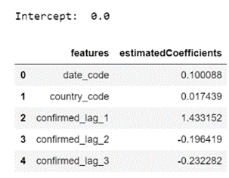
Is it possible to predict the trend of coronavirus cases for the whole world? - Lasso Regression
Both models are similar and their results have almost the same precision
However, Lasso Regression has an alternative penalty to Ridge (L1) which allows to reduce the weight (or even eliminate) the weight of those features that provoke multicollinearity
Explanatory: date, countries, target_variable_t-1, target_variable_t-2, target_variable_t-3
Target (one at a time): confirmed, deaths, active

Slide 8



Conclusions – How can we Improve the Analysis?
MORE DATA
OUR APPROACH
DATA
ENRICHMENT
Using an already
ingested dataset
Difficult dataset to work with
Limited dimensions
We applied different tecniques to the problem

Slide 9
April 17th , 2020
THANK YOU!
Predictive Analytics Course
Group 4 - Guida Giulia, Muttoni Davide, Ticozzi Paolo

